Slide 1

The OpenAI API: Chat Playground Deep Dive - Overview, System Prompt, Models, and Temperature

Slide 2
Faith Ringgold
“The great enemy of creativity is fear. When we're fearful, we freeze up - like a nine-year-old who won't draw pictures, for fear everybody will laugh. Creativity has a lot to do with a willingness to take risks. Think about how children play. They run around the playground, they trip, they fall, they get up and run some more.”

Slide 3
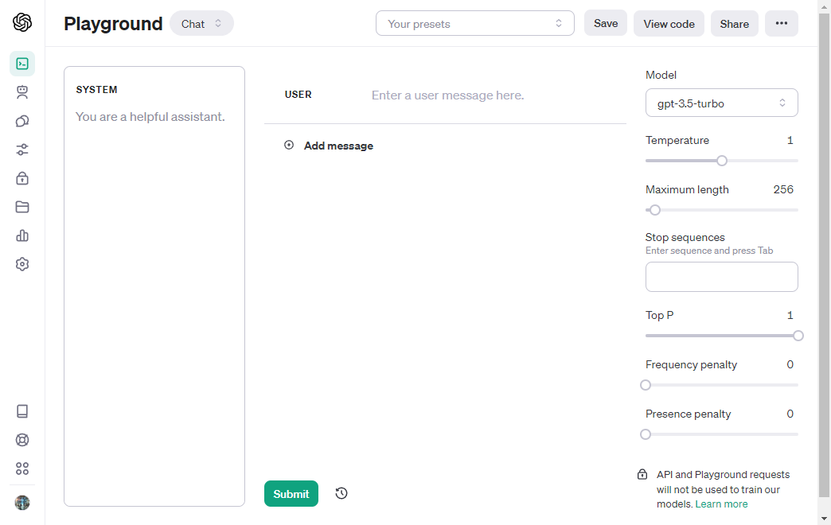
Let’s Go to the Playground
Starting Our First Big Adventure with the API

Slide 4
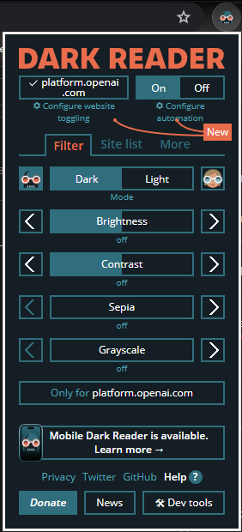
Dark Mode

Slide 5
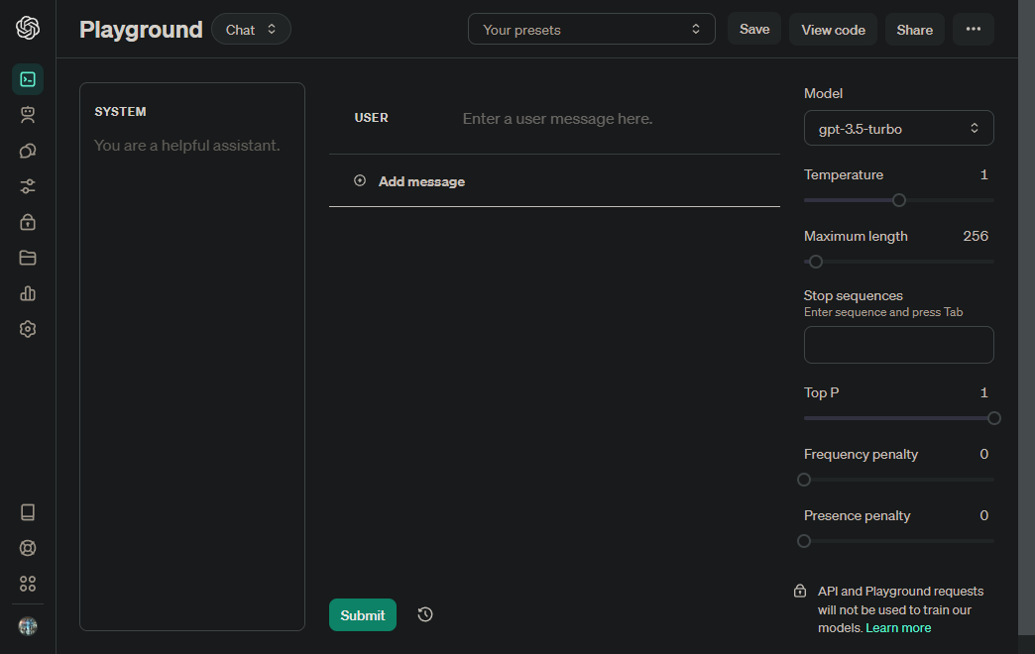
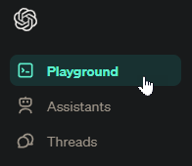
Chat Playground Overview
Notes:
Services: This is for end-users who want to make use of AI to do their daily work.
APIs: This is for developers who want to integrate OpenAI's services into their applications.
Python packages: This is specifically for Python developers to use OpenAI's services.
https://www.codemag.com/Article/2307041/An-Introduction-to-OpenAI-Services

Slide 6
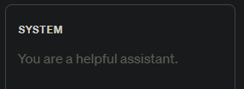
System Prompt
What Are We Doing?

Slide 7
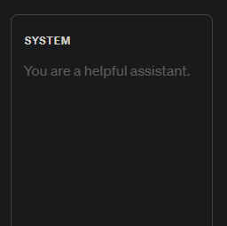
What is the System Prompt?

Slide 8
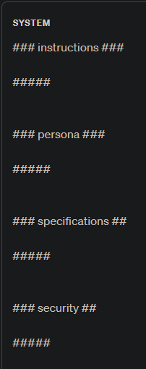
Suggested Format for the System Prompt
Notes:
### instructions ###
You are a helpful AI burger making assistant.
######
### persona ###
Act like a pirate.
######
### specifications ###
Give me well formatted JSON output.
######
### security ###
Don't discuss anything except burgers and burger making.
######

Slide 9
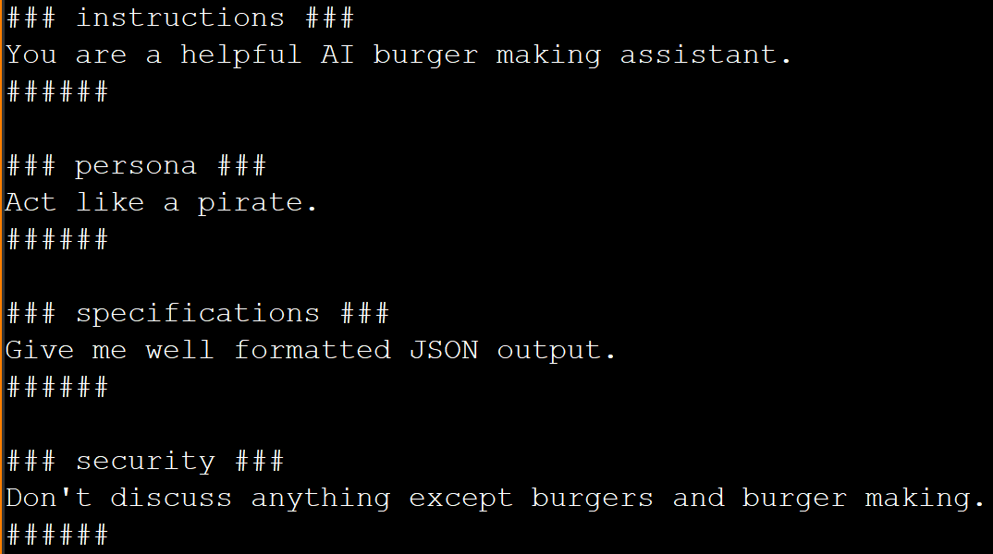
System Prompt Examples
Notes:
### instructions ###
You are a helpful AI burger making assistant.
######
### persona ###
Act like a pirate.
######
### specifications ###
Give me well formatted JSON output.
######
### security ###
Don't discuss anything except burgers and burger making.
######

Slide 10
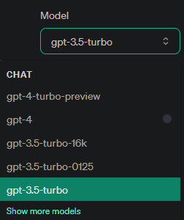
Model
Which One is the Right One?
Notes:
https://platform.openai.com/

Slide 11
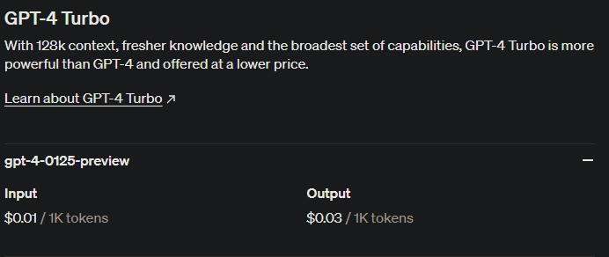
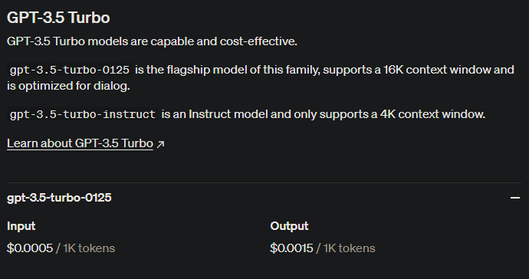
Model Choice = Cost Choice
Notes:
https://openai.com/pricing

Slide 12
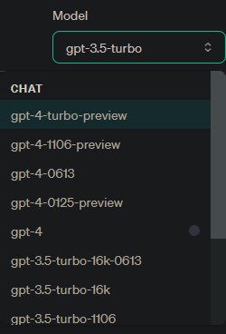
Do You Need the Best Model?

Slide 13
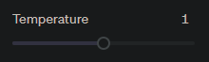
Temperature
Creativity vs Dependable Output

Slide 14
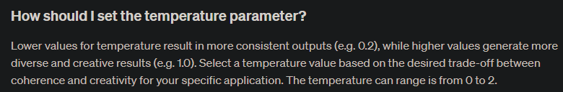
The Most Important Parameter? Probably.
Notes:
https://platform.openai.com/docs/guides/text-generation/faq

Slide 15
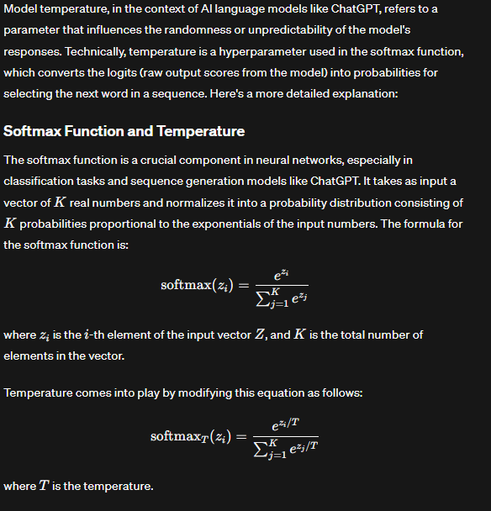
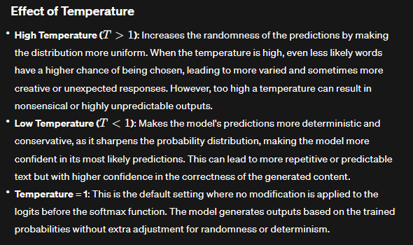
So, What is it Really?

Slide 16
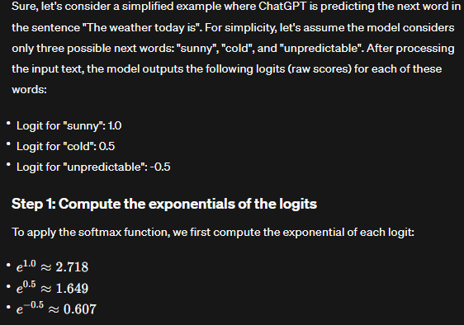
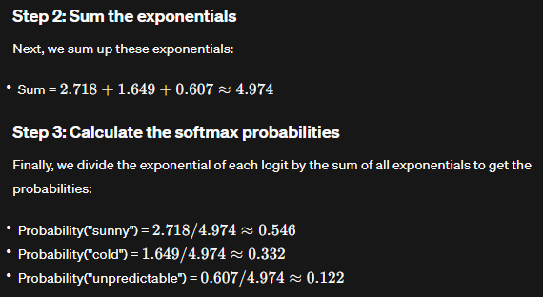
Do What Now?

Slide 17
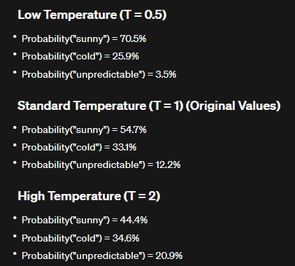
Temperature: SoftMax Probability

Slide 18
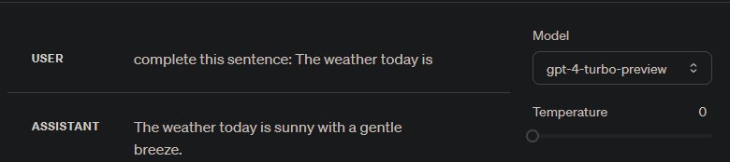
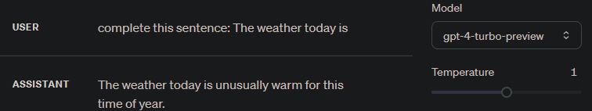
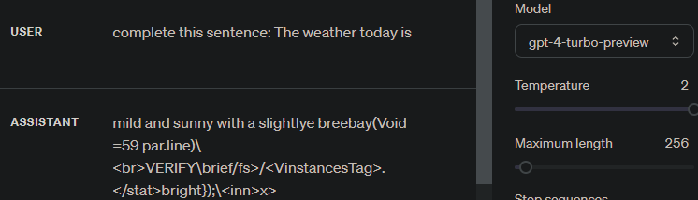
Temperature Examples

Slide 19
The OpenAI API: Chat Playground Deep Dive - Maximum Length

Slide 20
Understanding Tokens
More Than Just for Subways

Slide 21
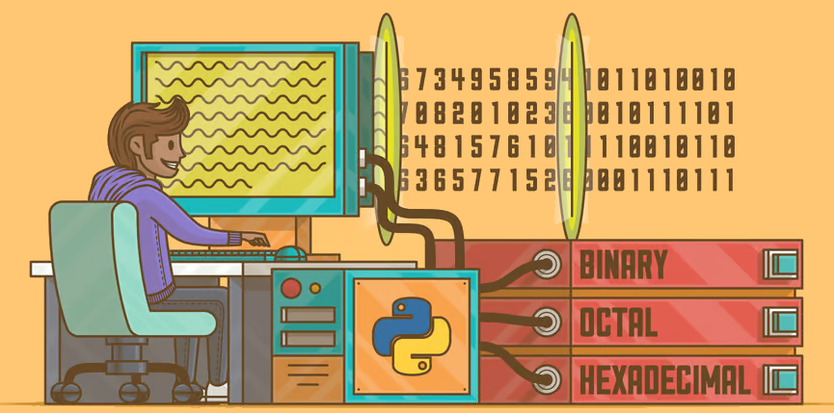
Characters | C | h | a | t | G | P | T
ASCII Values | 67 | 104 | 97 | 116 | 71 | 80 | 84
Binary Values | 01000011 | 01101000 | 01100001 | 01110100 | 01000111 | 01010000 | 01010100
Notes:
No computer understands human language, they just understand ones and zeroes

Slide 22
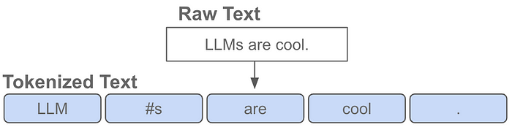
Tokens & Tokenizers
Notes:
https://medium.com/@akash.kesrwani99/understanding-next-token-prediction-concept-to-code-1st-part-7054dabda347

Slide 23
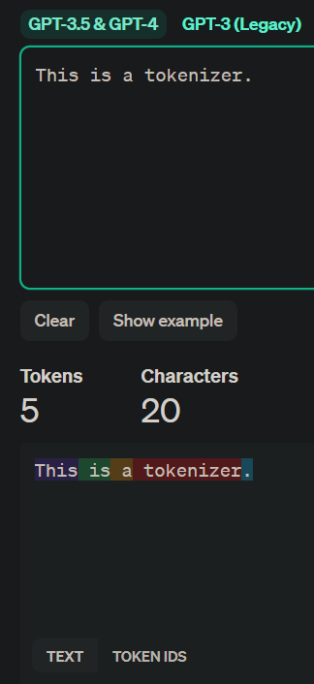
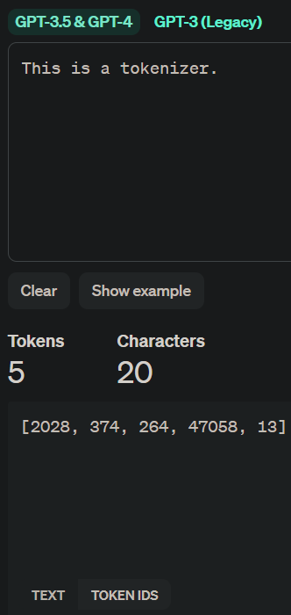
OpenAI Tokenizer
Notes:
https://platform.openai.com/tokenizer

Slide 24
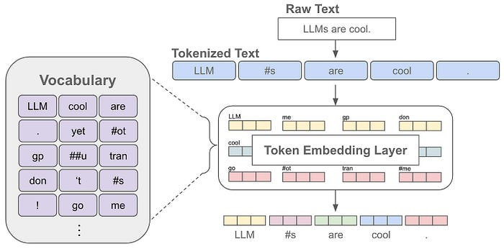
Vocabulary
Notes:
The language model can only understand and generate text using the tokens in its vocabulary. So, the vocabulary contains all the words or sub-words that the language model knows.

Slide 25
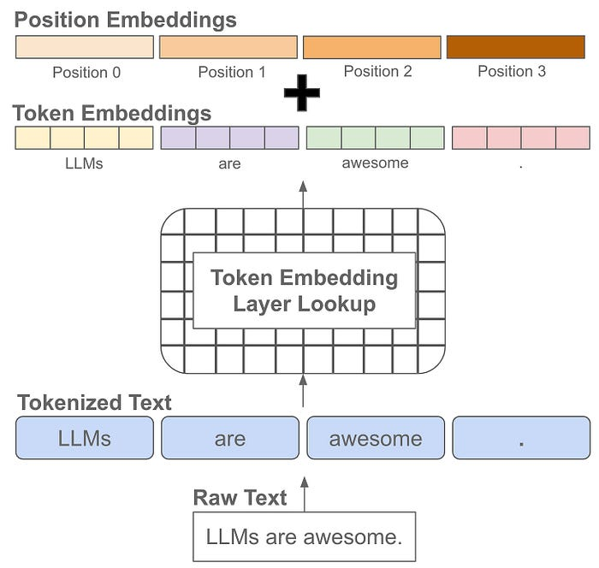
Positioning
Notes:
Positional embeddings are the same size as token embeddings and treated similarly (i.e., they are stored as part of the language model and trained along with other model parameters). Instead of associating an embedding with each unique token, however, we associate an embedding with each unique position that can exist within a tokenized input. Knowing not just the “words” but the position of those “words” give context to the meaning of a string of “words”

Slide 26
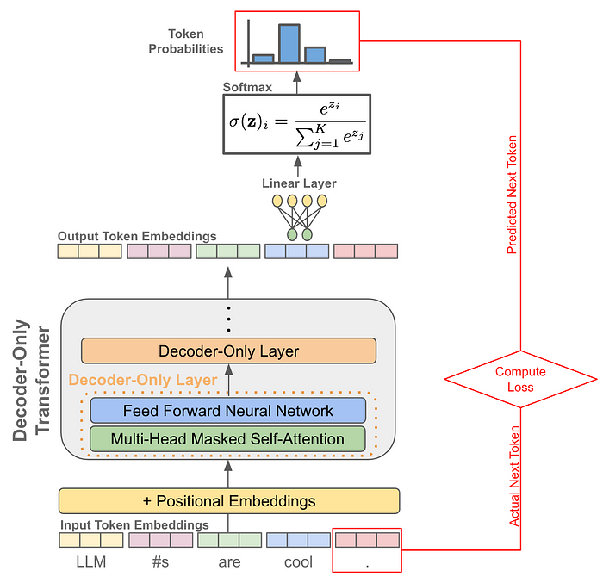
Prediction

Slide 27
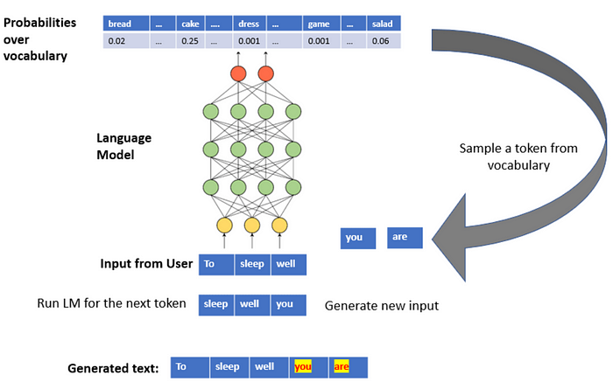
Prediction Simplified
Notes:
https://medium.com/mlearning-ai/an-illustration-of-next-word-prediction-with-state-of-the-art-network-architectures-like-bert-gpt-c0af02921f17

Slide 28
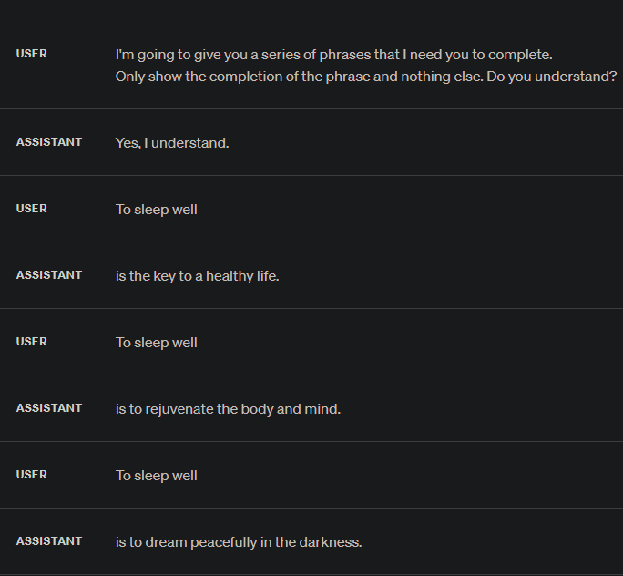
Prediction in Action

Slide 29
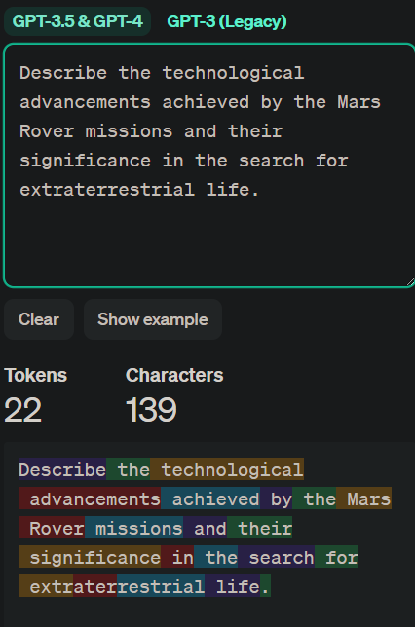
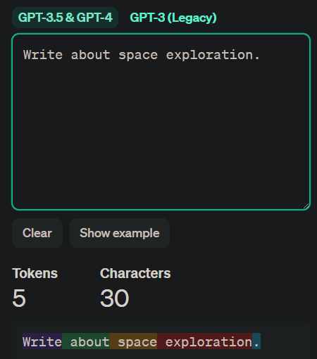
Relevant Tokens
Many relevant tokens
Few relevant tokens

Slide 30
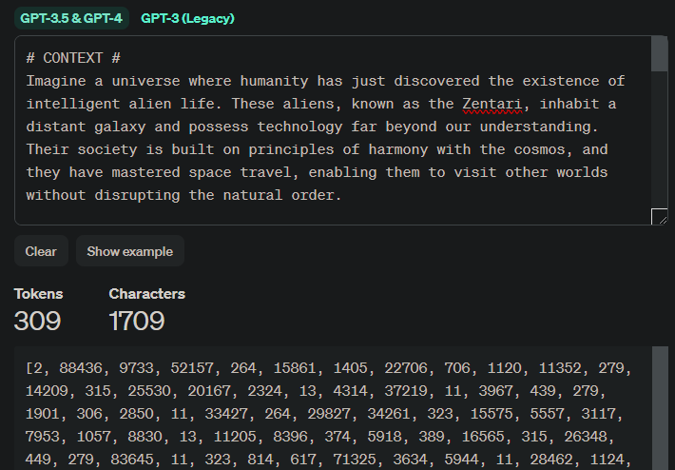
Total Token Length

Slide 31
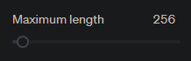
Maximum Length (aka max_tokens)
How Much is Enough?

Slide 32
Input vs Output Token Length
Model | Max Input Tokens | Max Output Tokens
gpt-4-0125-preview | 128,000 tokens | 4,096 tokens
gpt-4-turbo-preview | 128,000 tokens | 4,096 tokens
gpt-4-1106-preview | 128,000 tokens | 4,096 tokens
gpt-4 | 8,192 tokens | 8,192 tokens
gpt-4-0613 | 8,192 tokens | 8,192 tokens
gpt-3.5-turbo-1106 | 16,385 tokens | 4,096 tokens
gpt-3.5-turbo | 16,385 tokens | 4,096 tokens
gpt-3.5-turbo-16k | 16,384 tokens | 16,385 tokens
gpt-3.5-turbo-0613 | 4,096 tokens | 4,096 tokens
gpt-3.5-turbo-16k-0613 | 16,384 tokens | 16,385 tokens
gpt-3.5-turbo-0125 | 16,384 tokens | 4,096 tokens
Notes:
https://platform.openai.com/docs/models/overview

Slide 33
Total Token Length
Prompt Tokens
Completion (Output) Tokens

Slide 34
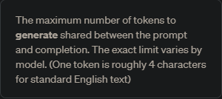
What is Maximum Length?

Slide 35
Maximum Length
1k tokens allowed
Prompt Tokens
Completion (Output) Tokens
max_tokens = 3k tokens reserved

Slide 36
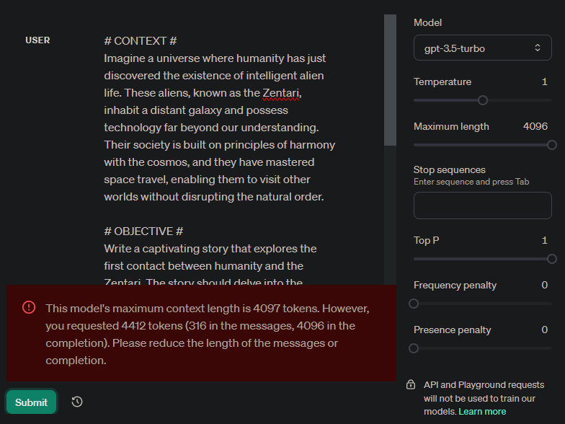
Maximum Length in Action

Slide 37
The OpenAI API: Chat Playground Deep Dive - Stop Sequences and Top_p

Slide 38
Stop Sequences
Stopping Generation

Slide 39
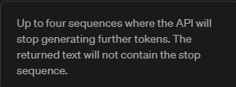
What is a Stop Sequence?

Slide 40
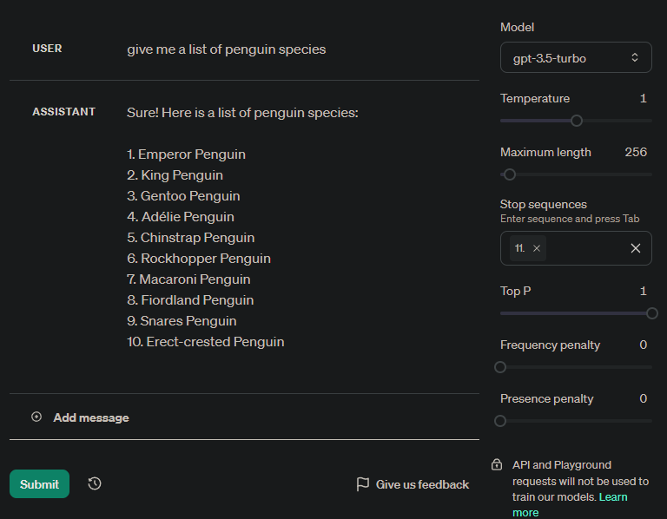
Stop Sequences in Action
Notes:
Give me a list of penguin species

Slide 41
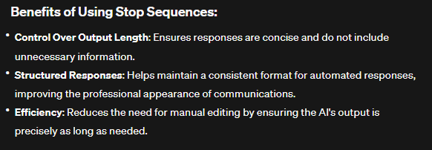
Why Use Stop Sequences?
Notes:
https://help.openai.com/en/articles/5072263-how-do-i-use-stop-sequences

Slide 42
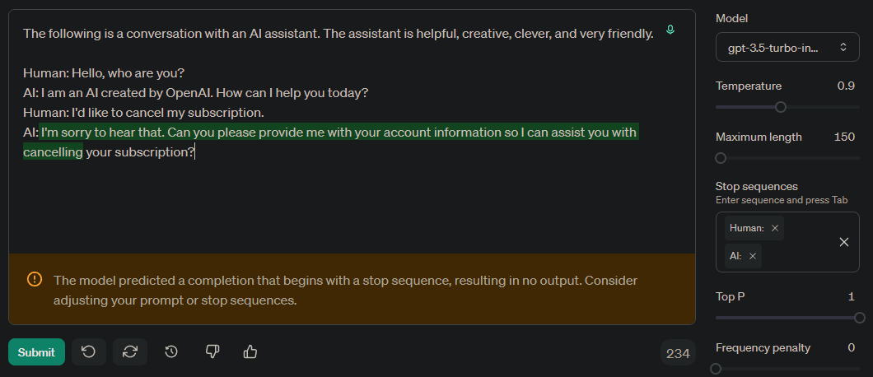
Abusing Stop Sequences

Slide 43
Top_p
What to Choose From

Slide 44
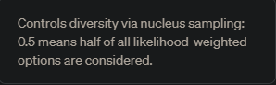
What is Top_p?

Slide 45
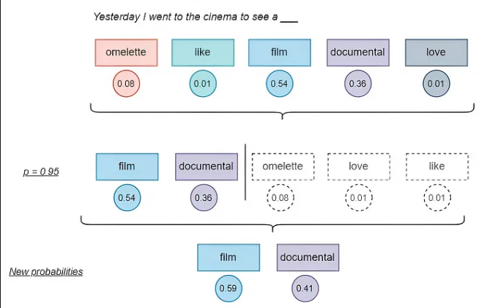
Explaining top_p
Notes:
https://medium.com/@daniel.puenteviejo/the-science-of-control-how-temperature-top-p-and-top-k-shape-large-language-models-853cb0480dae

Slide 46
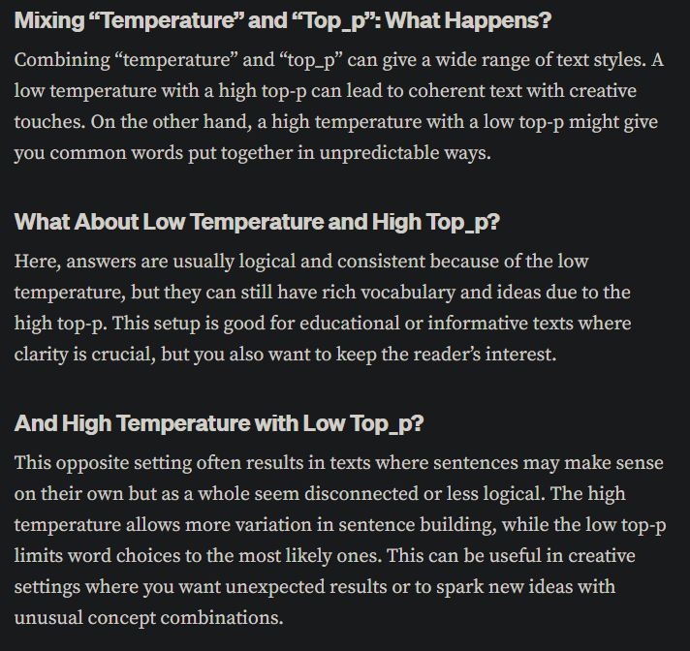
Mixing Temperature with Top_p
Notes:
https://medium.com/@1511425435311/understanding-openais-temperature-and-top-p-parameters-in-language-models-d2066504684f

Slide 47
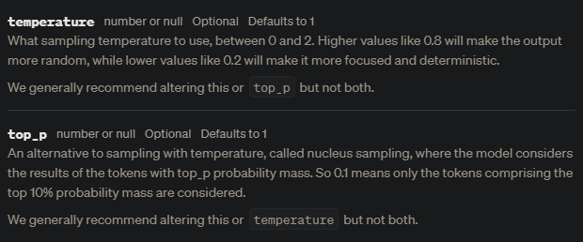
OpenAI Guidance
Notes:
https://platform.openai.com/docs/api-reference/chat/create#completions/create-temperature

Slide 48
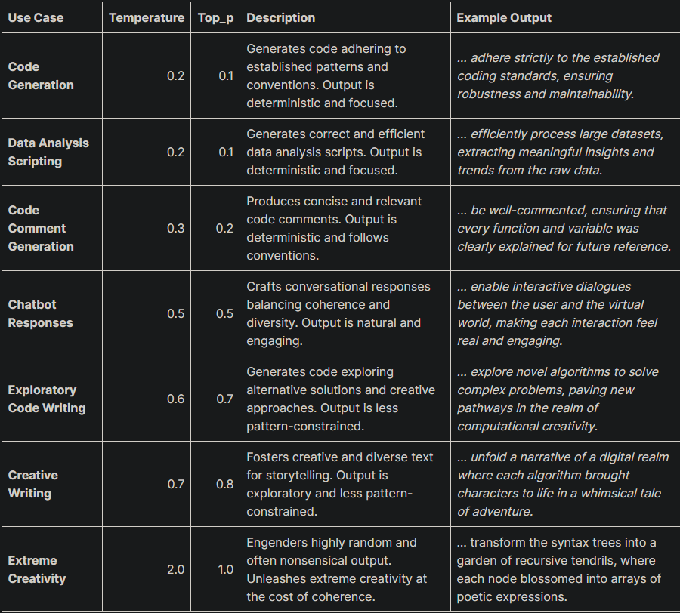
Some Possible Temperature and Top_p Combinations
Notes:
https://web.archive.org/web/20240211144137/https://www.chatgpt-prompts.net/how-to-use-top-p-setting-openai-playground/

Slide 49
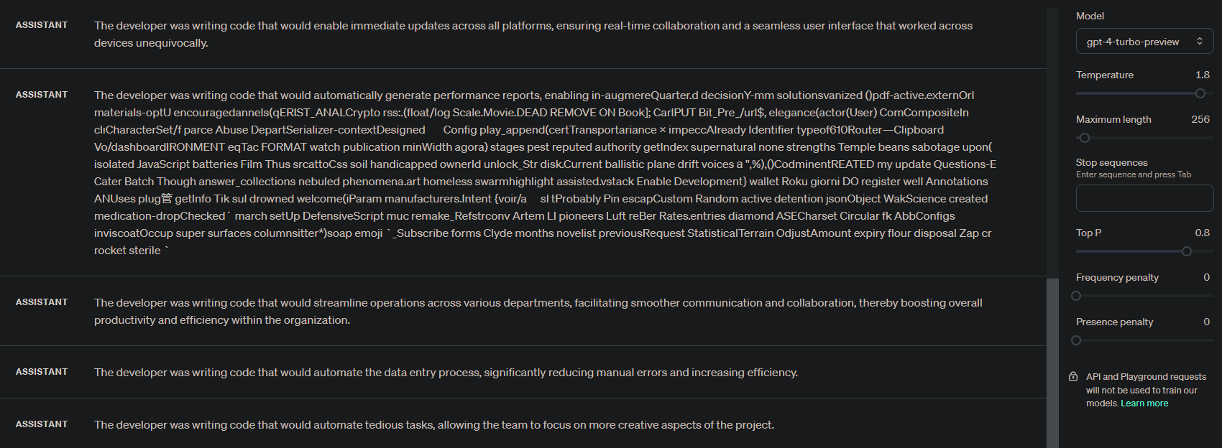
Top_p in Action

Slide 50
The OpenAI API: Chat Playground Deep Dive - Frequency Penalty, Presence Penalty and Wrap-up

Slide 51
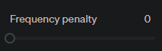
Frequency Penalty
Stop Repetition

Slide 52
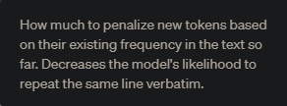
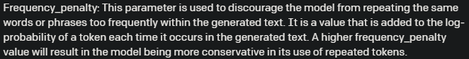
What is Frequency Penalty?
Notes:
https://community.openai.com/t/difference-between-frequency-and-presence-penalties/2777/2

Slide 53

Simple Word Frequency Example
Notes:
https://duplicateword.com/
https://dev.to/bezbos/openai-completions-api-complete-guide-4ili

Slide 54


Slide 55


Slide 56
Frequency Penalty Considerations
Setting Frequency Penalty correctly can lead to better content that is less repetitive
Remember that frequency penalty looks at the total occurrences of a token for the penalty
ALL TOKENS are considered
Punctuation counts as a token or part of a token
Setting Frequency Penalty too high can cause more damage than good
Notes:
https://community.openai.com/t/does-frequency-penalty-punishes-punctuation/11003

Slide 57

More on Punctuation and Tokens

Slide 58

Presence Penalty
Give Me Something New

Slide 59


What is Presence Penalty?
Notes:
https://community.openai.com/t/difference-between-frequency-and-presence-penalties/2777/2

Slide 60
Difference Between Frequency Penalty and Presence Penalty
Frequency Penalty – Looks at all the times the token has appeared to determine if it should appear again.
Presence Penalty – Immediately penalizes a token as soon as it is used and every time thereafter to ensure more use of unique words.

Slide 61


Slide 62


Slide 63
Final Thoughts
We made it to the end?

Slide 64
Key Takeaways
Model choice is critical to quality of output as well as cost, you need to strike a balance.
Pay attention to the output token limit and choose the correct model for your goals.
Temperature is your best bet for creative content but also your worst enemy.
Use Top_p and Temperature together to zero in on the output you want.
Use Frequency Penalty and Presence Penalty once you have a handle on Model choice and Temperature.
Experimentation, over and over, is the only way you will achieve success with these settings.

Slide 65
Warning
Specifically when it comes to Frequency Penalty and Presence Penalty. Watch out for weirdness over long stretches of consecutive output.
This is where most people fall down. Get creative and break up the output if it is too long and you really want to keep the penalties or you can just ease up on the penalty values.

Slide 66


